Slide 1

AAD & DAD
Algorithm-aided Design
Data-aided Design
2021.10.29

Slide 2
The EVOLUTION OF AN ARCHITECT
Analog
CAD
DAD
Generative
– Drawing Board
– Computer aided Design
– Data aided Design
– Algorithm led Design.

Slide 3
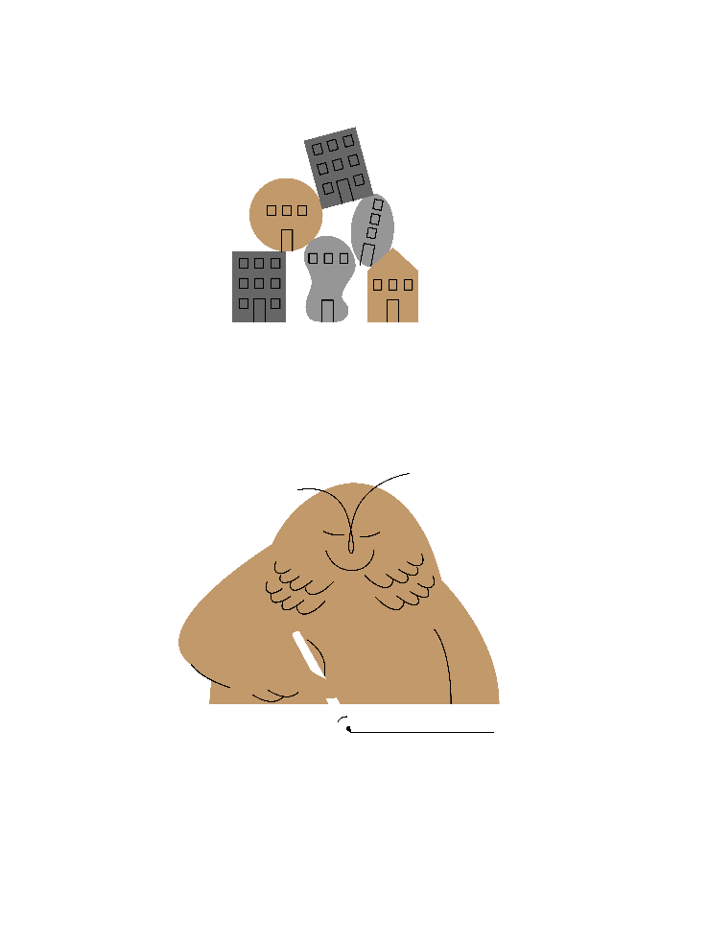
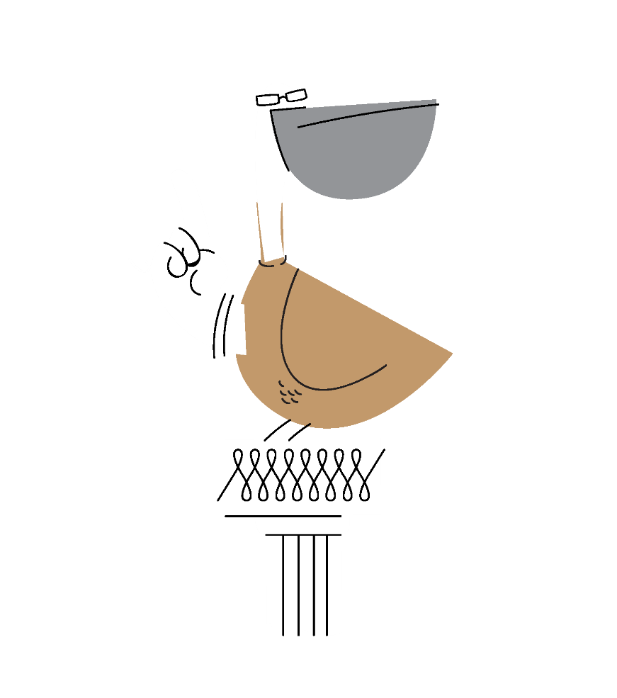
The impact of the tool
HOW WE WORK
HOW WE THINK
Product Development
Development Process

Slide 4
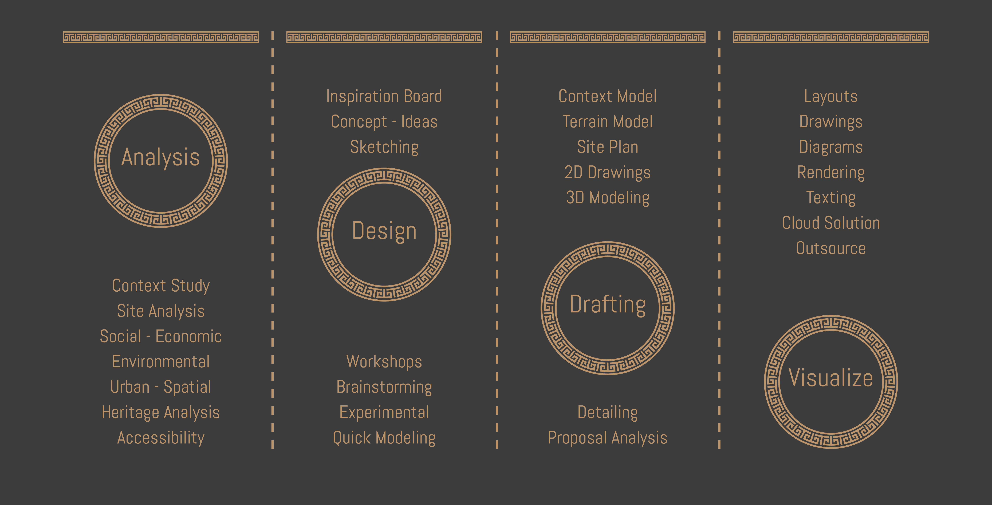
Project development
Linear Staging Process

Slide 5
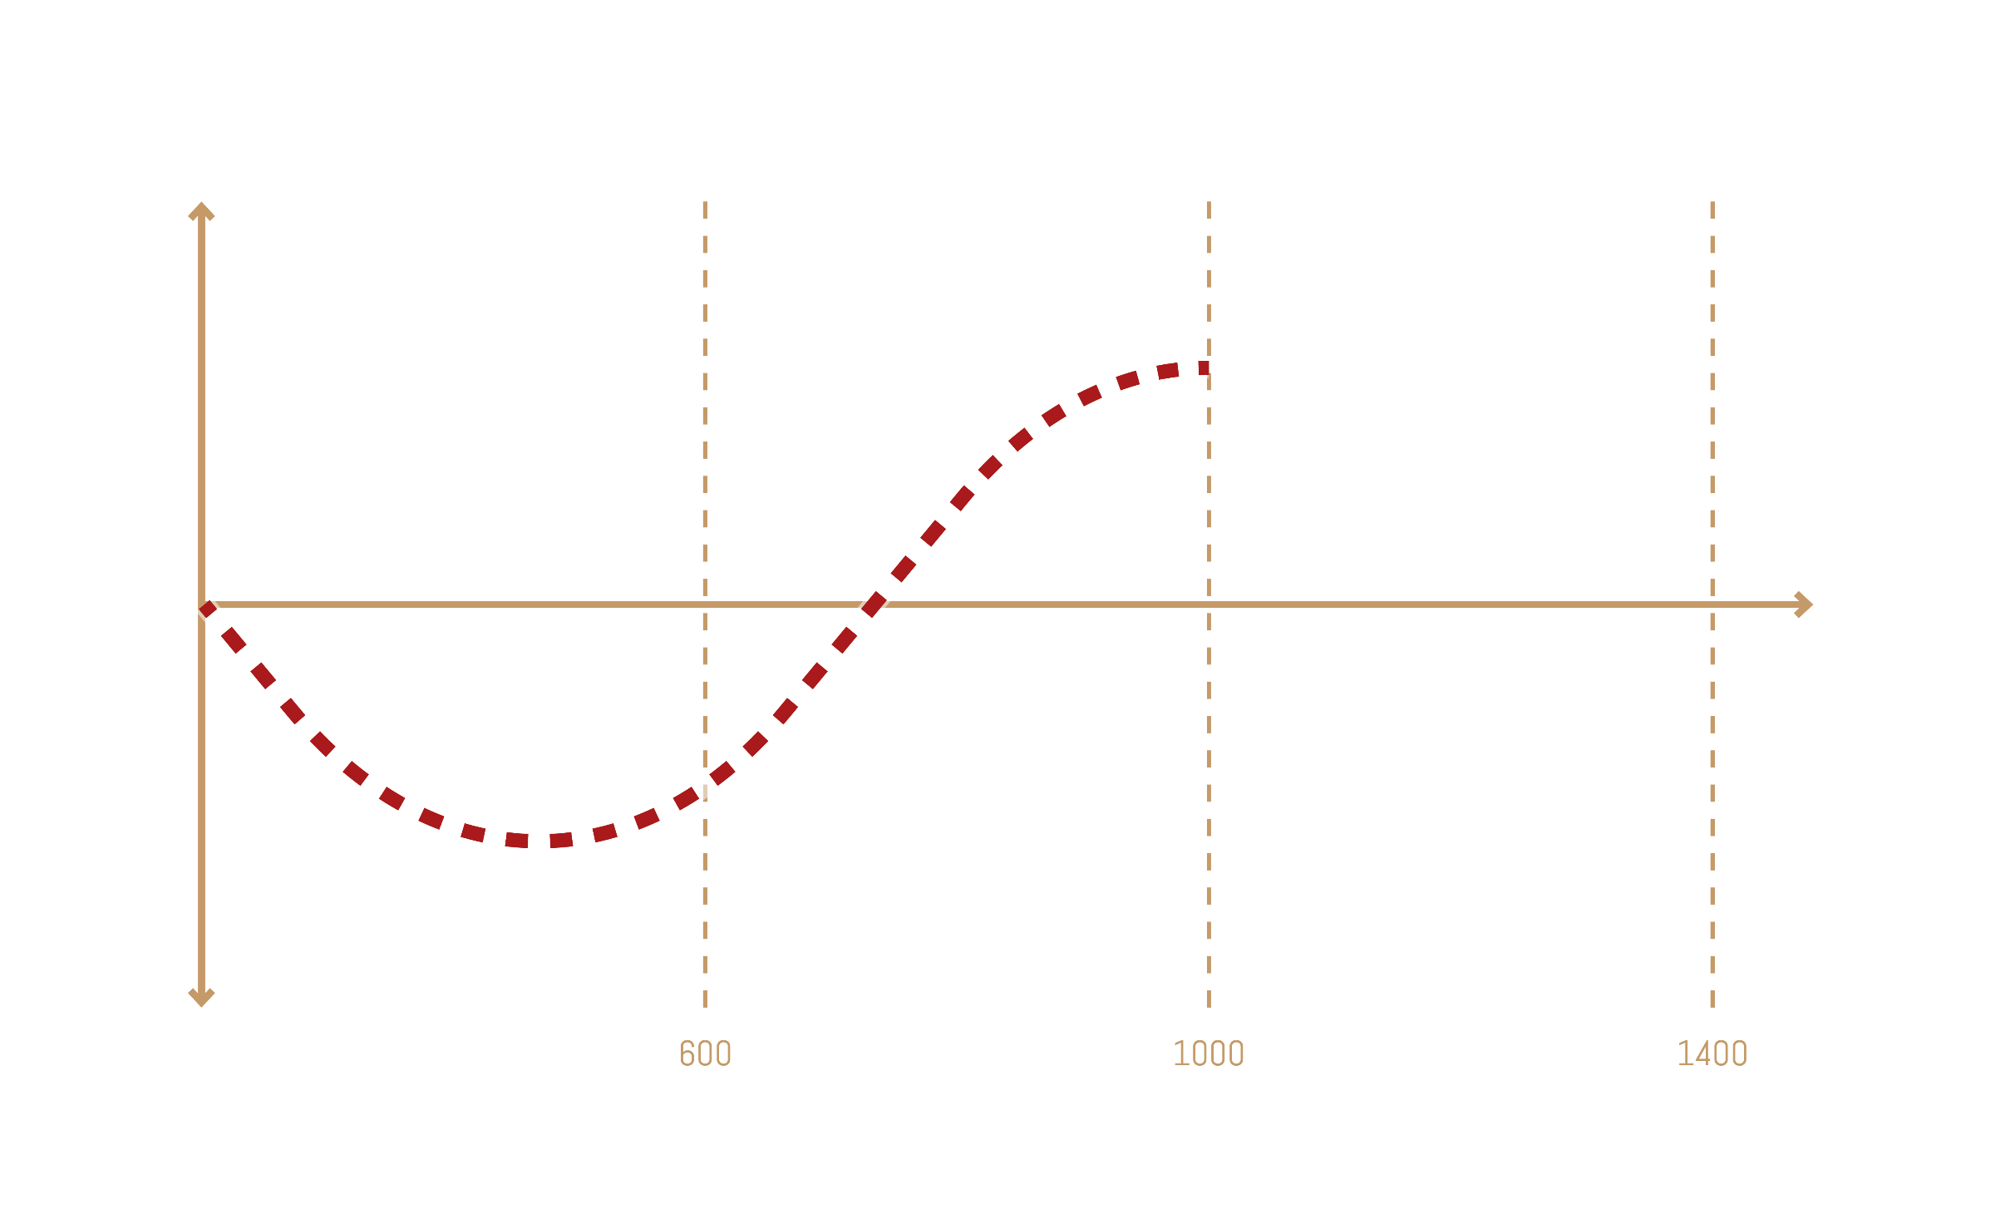
Output Quality
Project Budget
Depth of Study

Slide 6
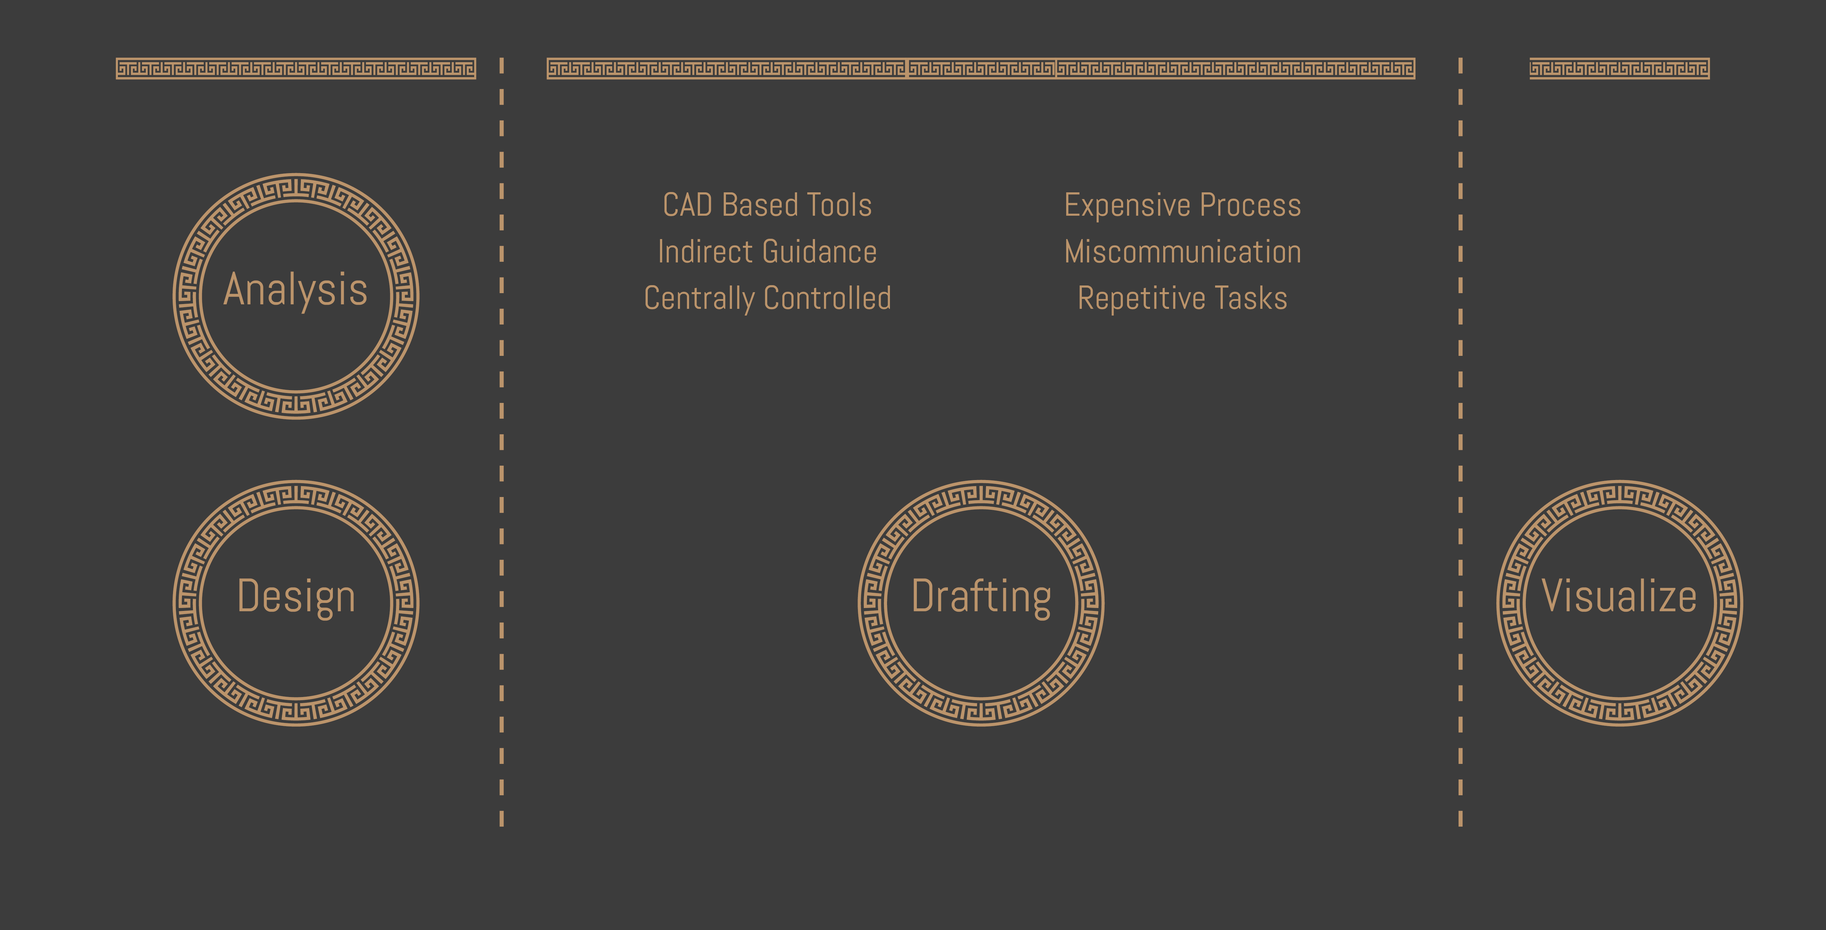
Project budget
CAD-based Process

Slide 7
ref

Slide 8
Project development
Linear Staging Process

Slide 9
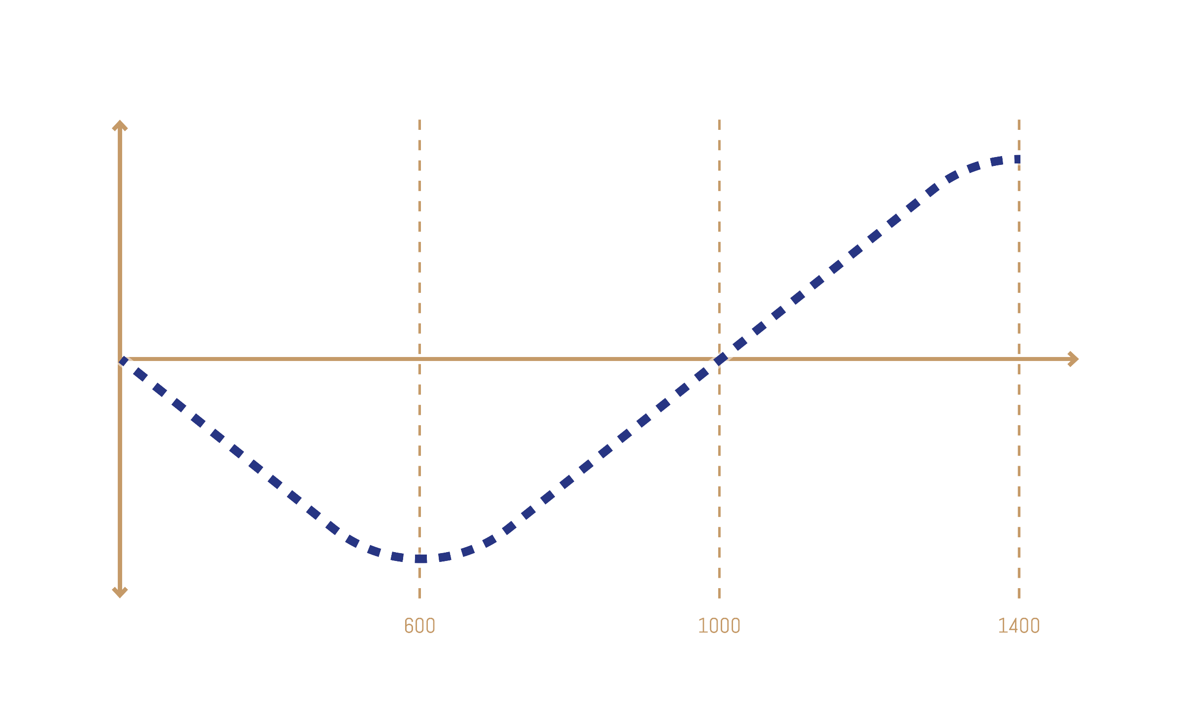
Output Quality
Project Budget
Depth of Study

Slide 10
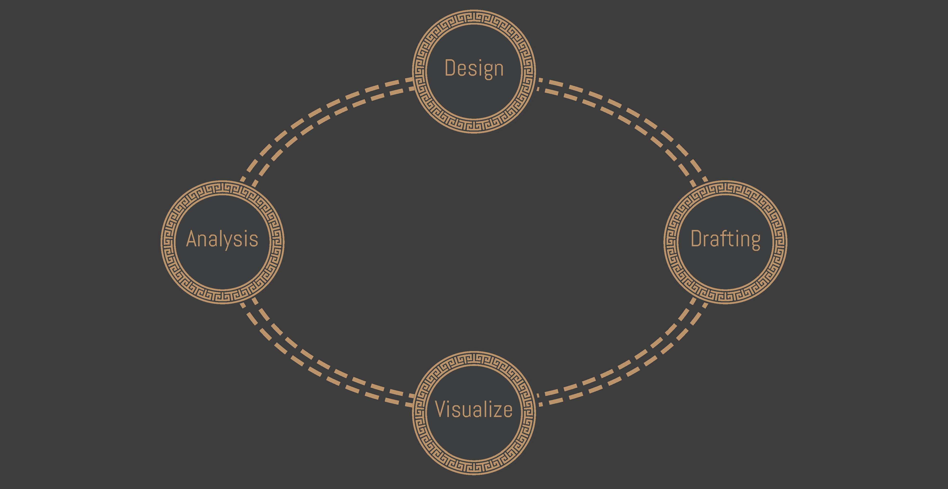
Project development
Algorithm-based Process

Slide 11
ref

Slide 12
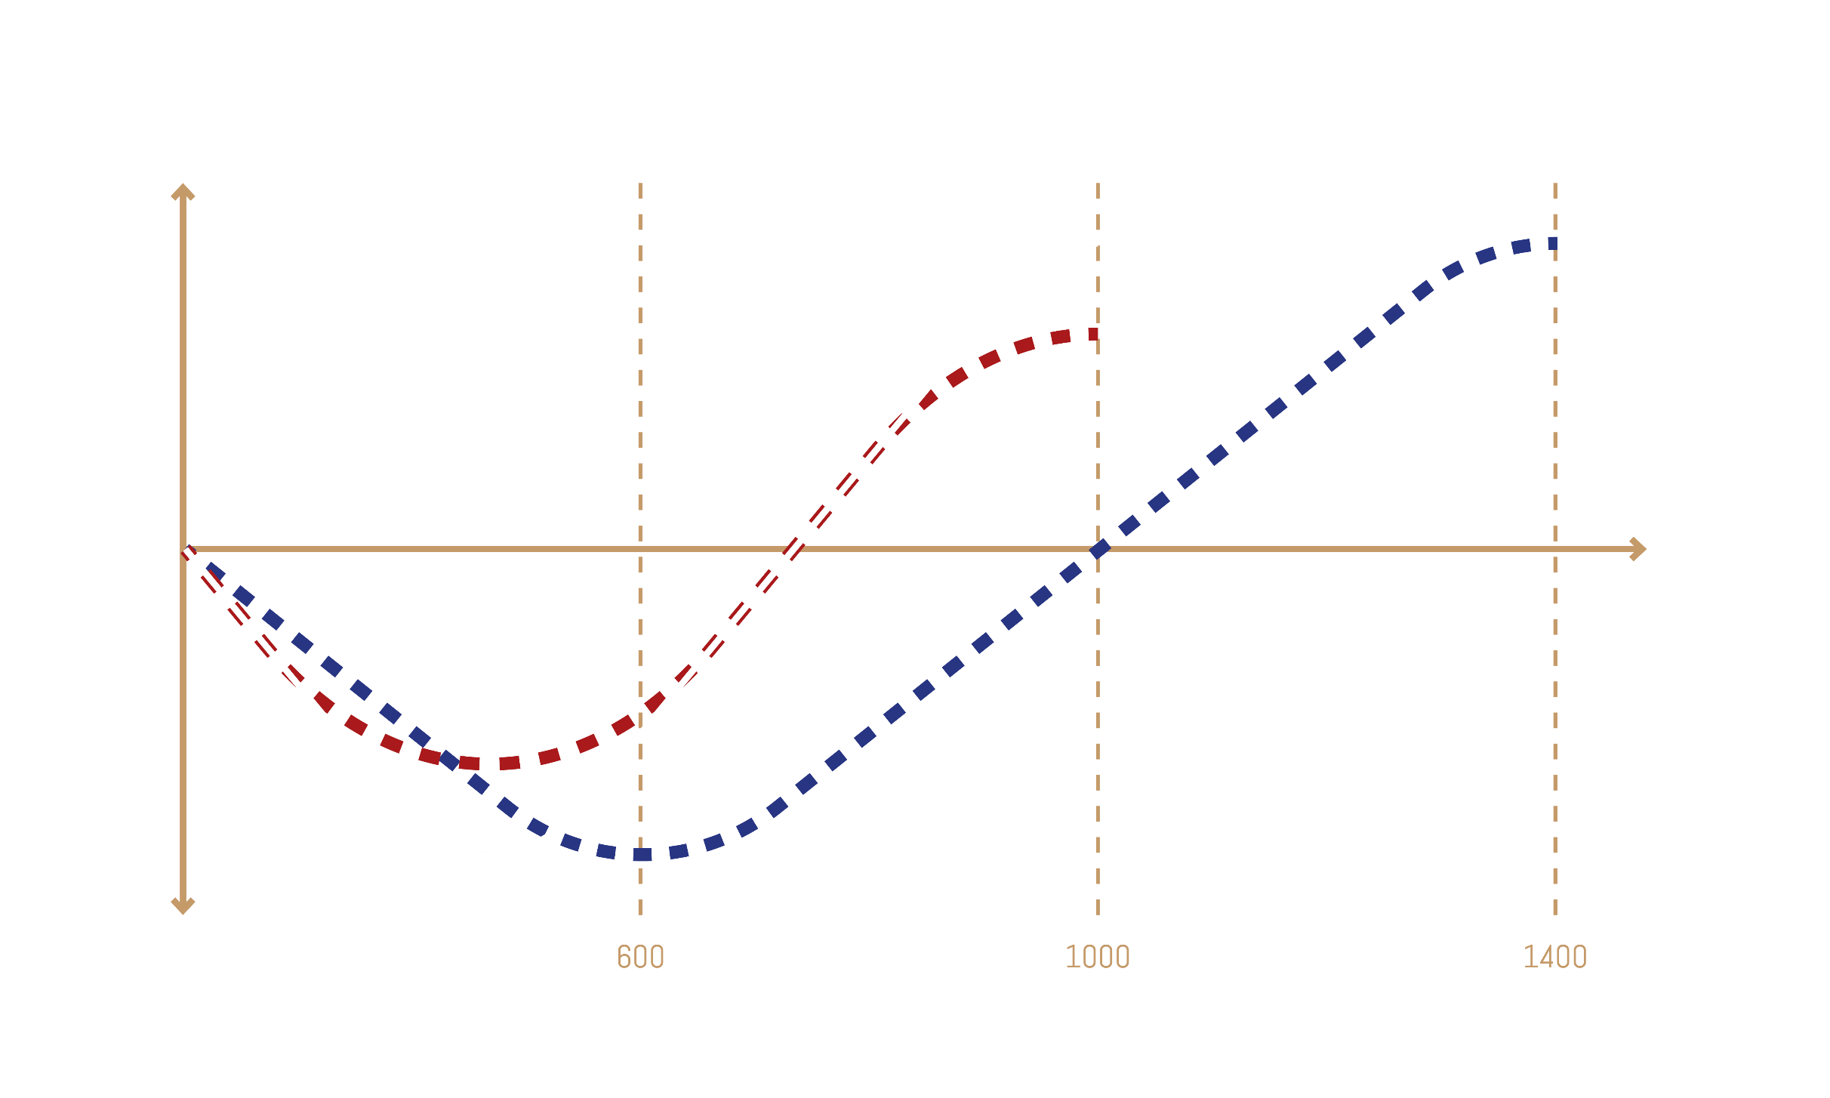
Output Quality
Project Budget
Depth of Study

Slide 13
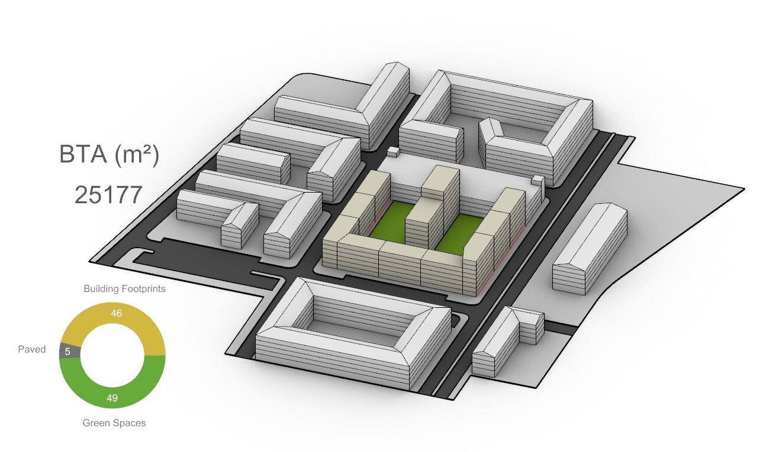
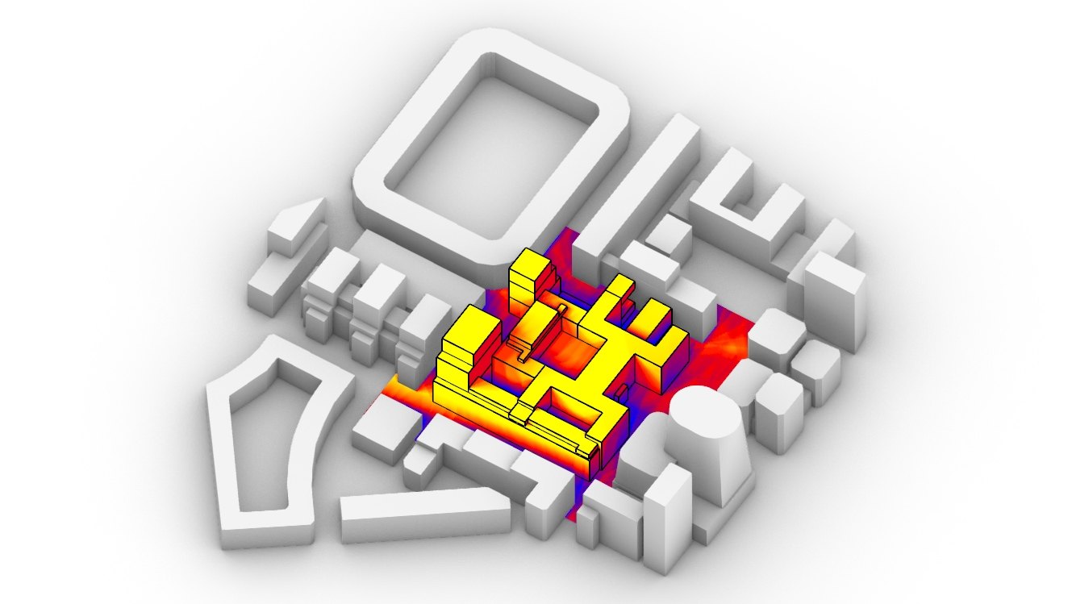
AAD & DAD
PROCESS AUTOMATION
ANALYTIC SYSTEM
Drafting & Design
Data Aided Approach

Slide 14
AAD & DAD
PROCESS AUTOMATION
ANALYTIC SYSTEM
= Higher Margin + Operational Scaling
= More Accurate + Higher Quality

Slide 16
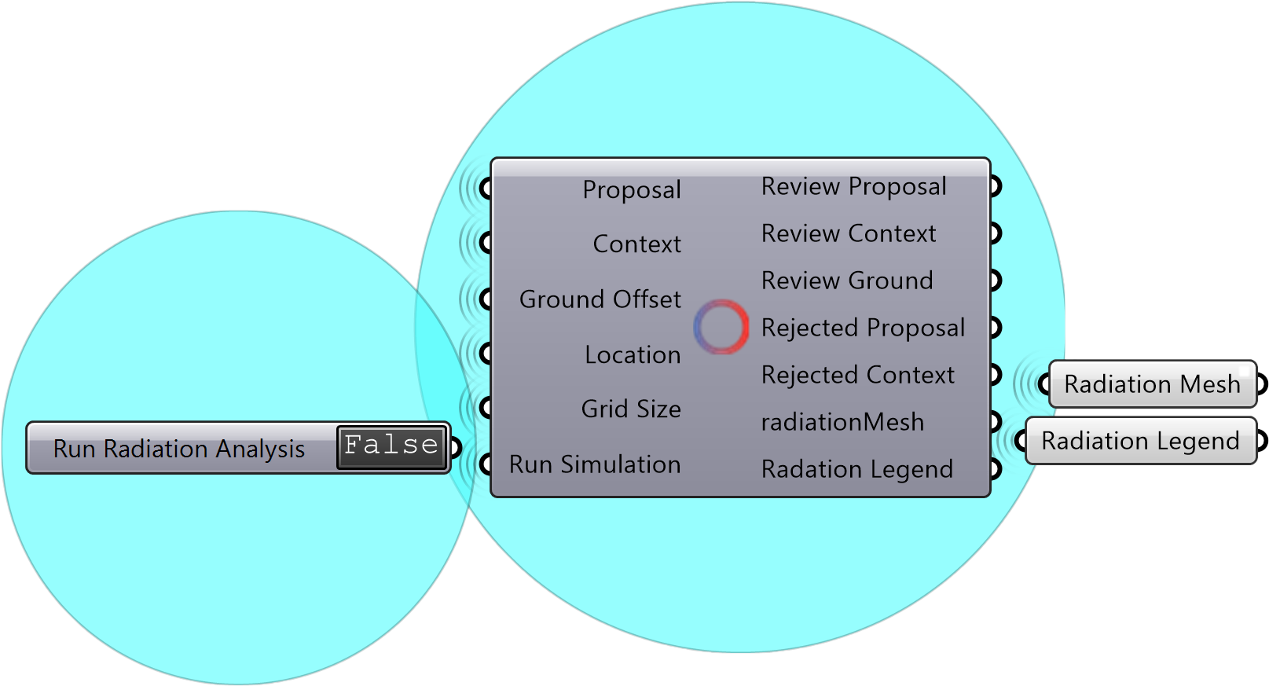
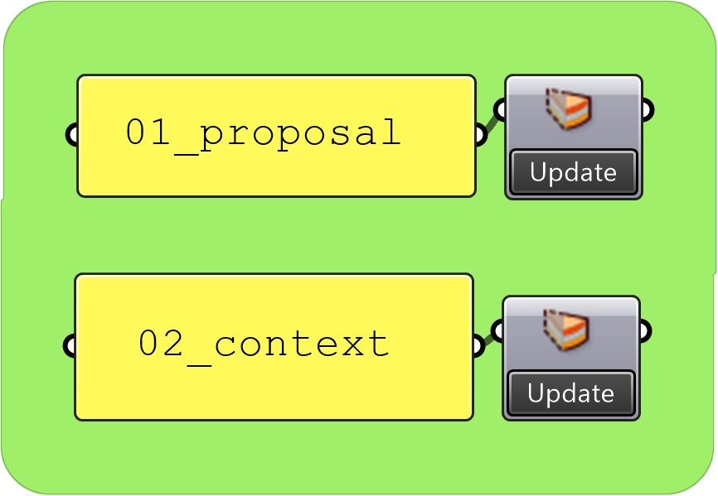
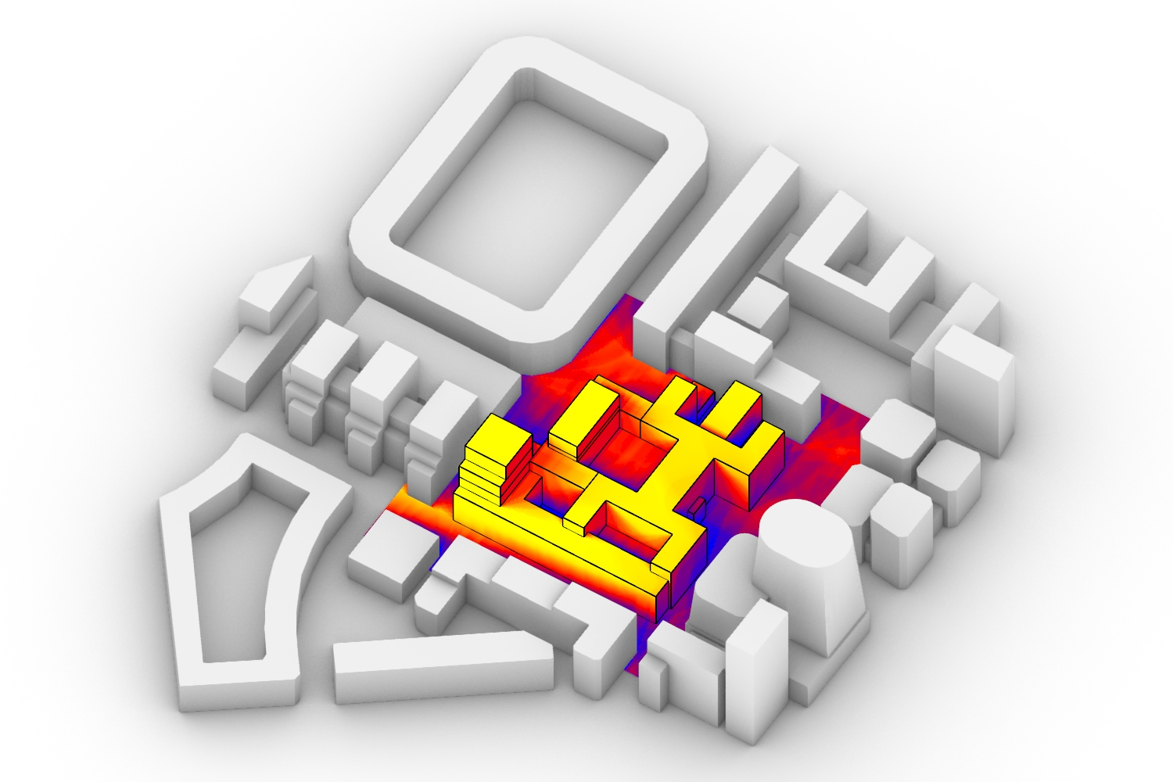
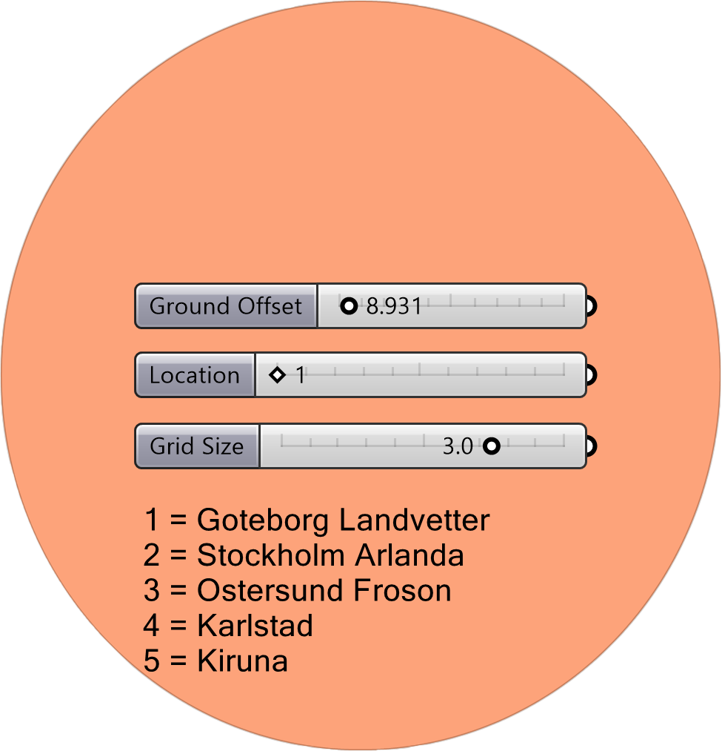
HOW ?!
Import from SketchUp
Few Clicks
16 – 20 hours (15-20k sek)
10-15 Minutes
3
Run
4
Enjoy
1
Import
2
Choose

Slide 17
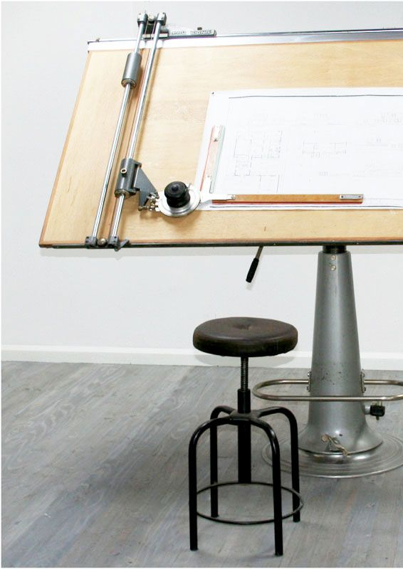
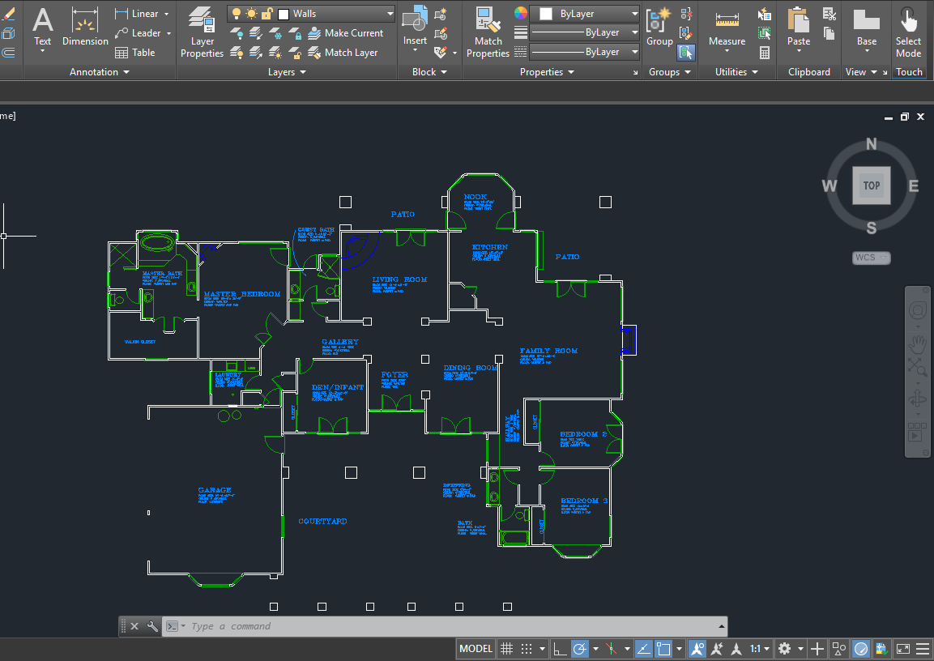
Notes:
Det vi gör på jobbet. Hur vi ska uppnå vår vision.

Slide 18
Save
Scale
Undo
Copy
Print
Archive
Modify
Notes:
Det vi gör på jobbet. Hur vi ska uppnå vår vision.

Slide 19
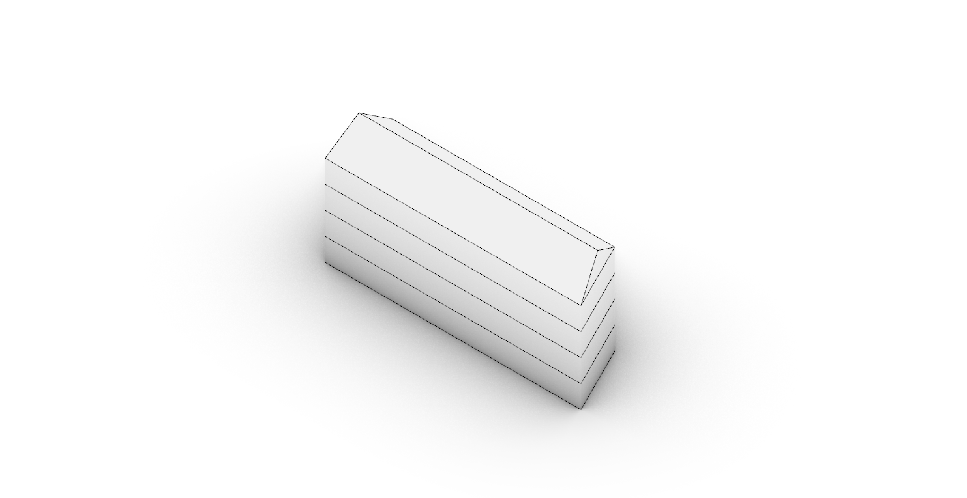
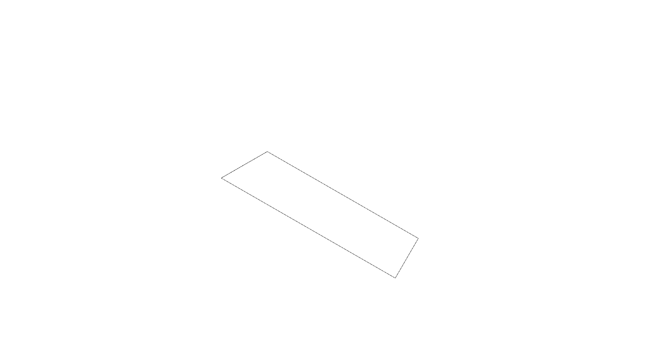
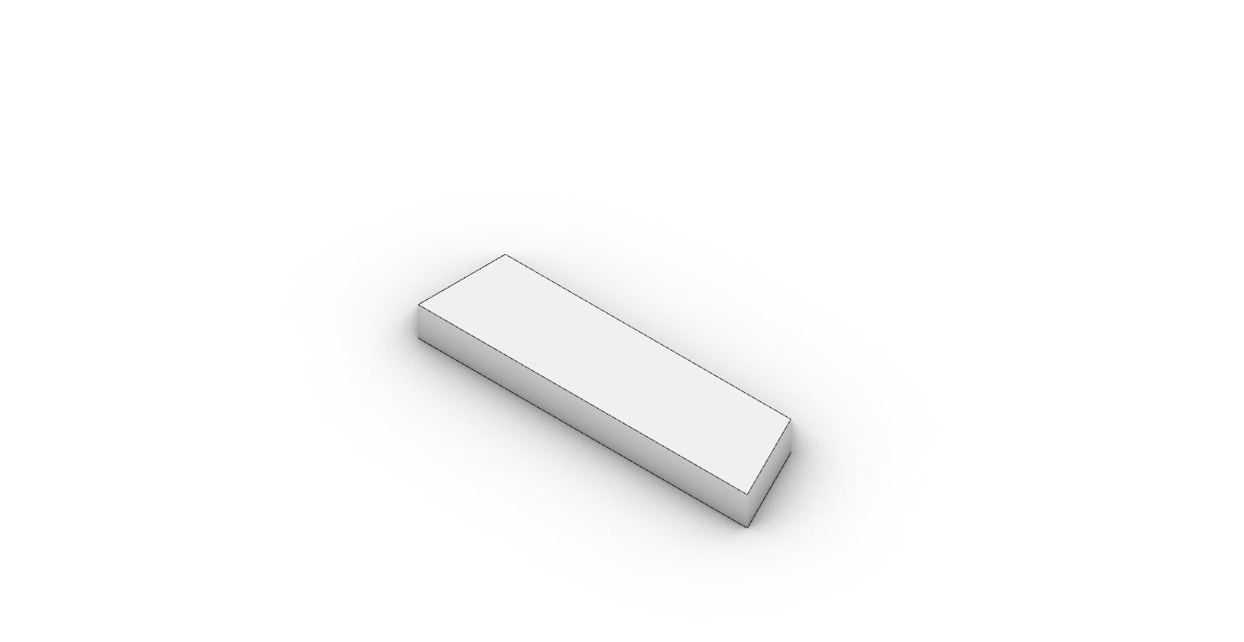

CAD = Direct Modelling
Computer Aided Design
Click-Based Technology

Slide 20
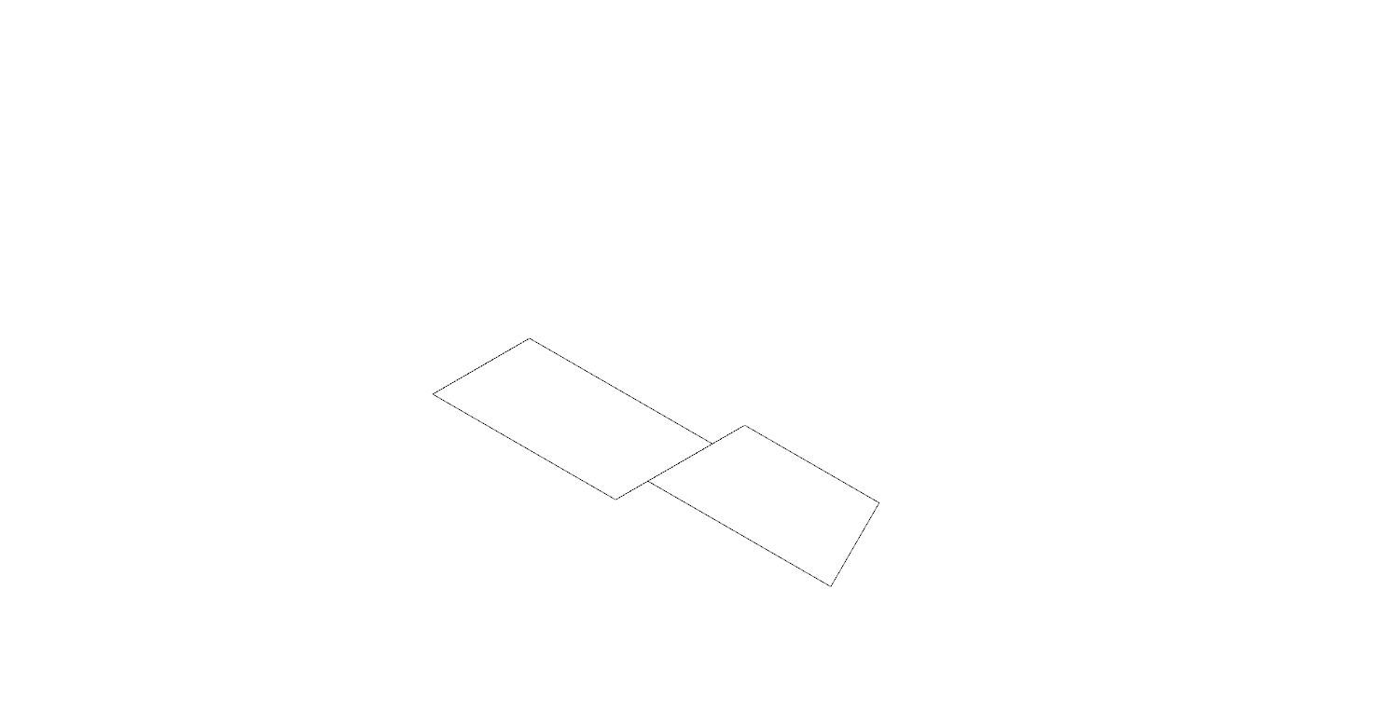
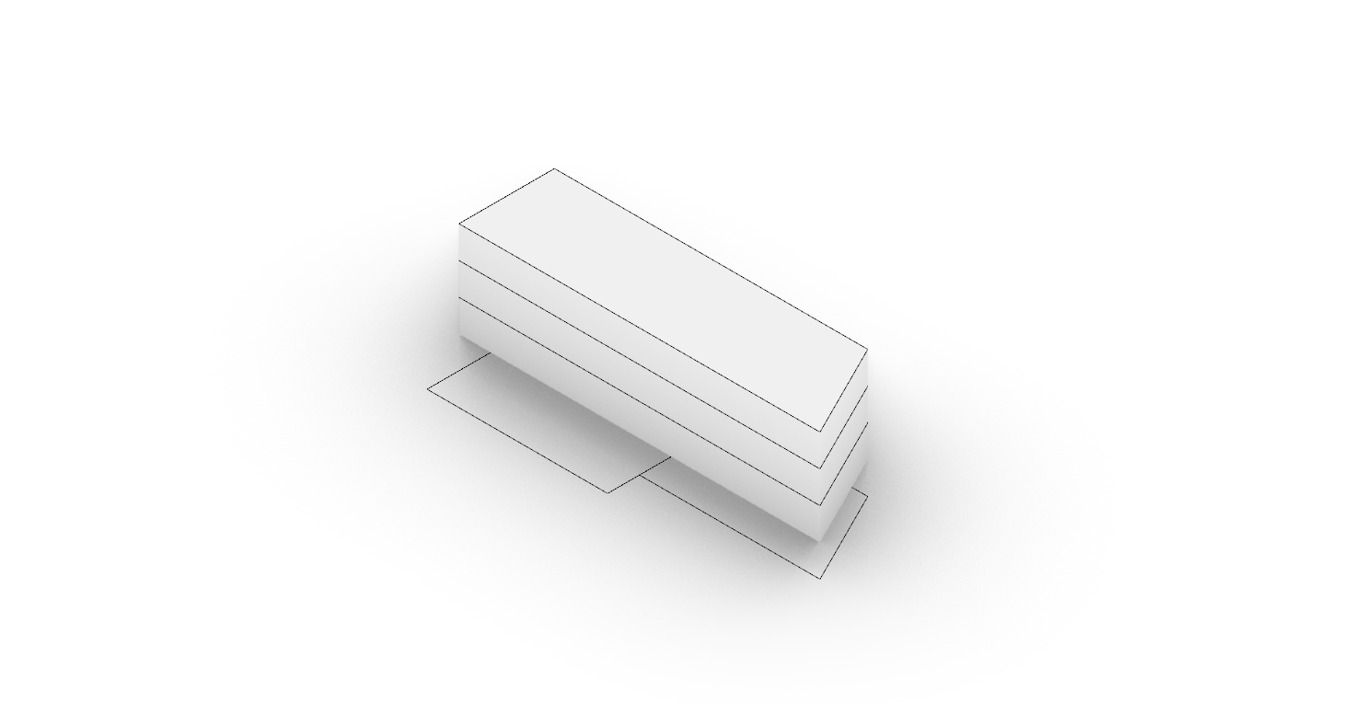
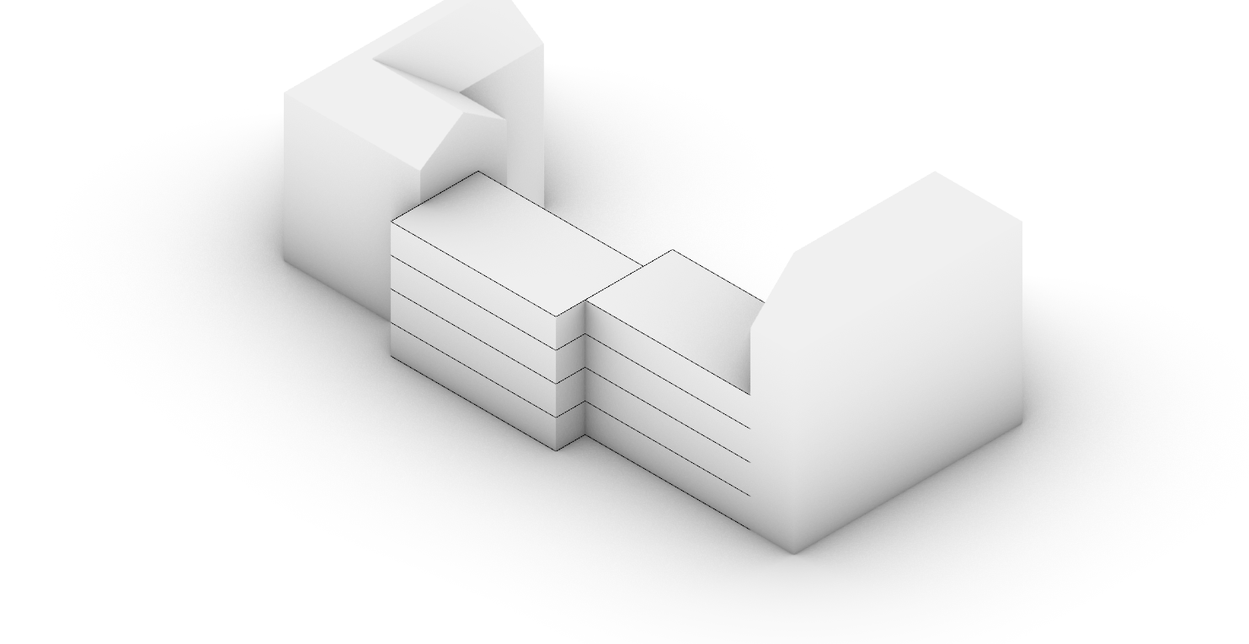
CAD = Direct Modelling
Unanalysable Outcome
Nonadaptive Geometry

Slide 21
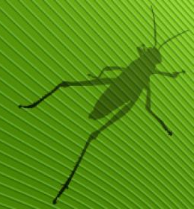
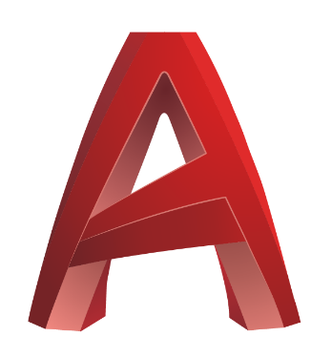
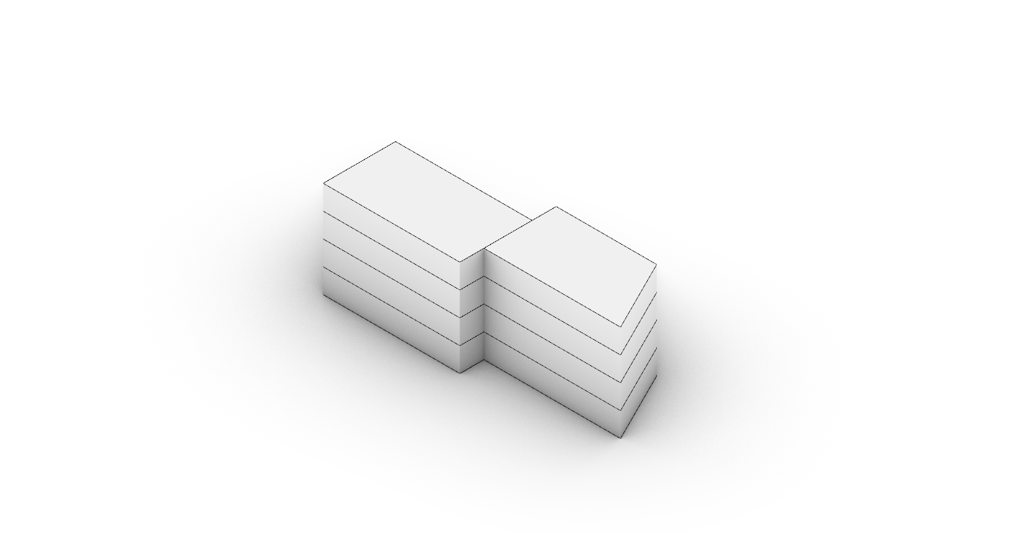
Grasshopper
CAD Software
Algorithm Based
Click-Based
Indirect Modelling
Direct Modelling
Adaptive Geometry
Nonadaptive Geometry
Analysable Outcome
Unanalysable Outcome
Recyclable Product
Non-recyclable Product

Slide 22
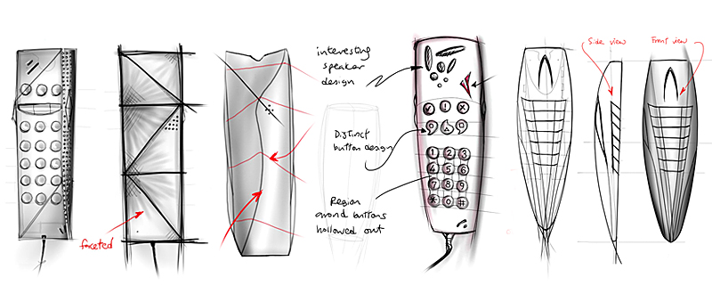
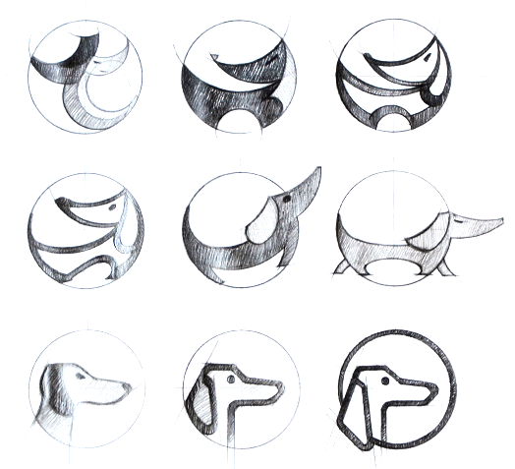
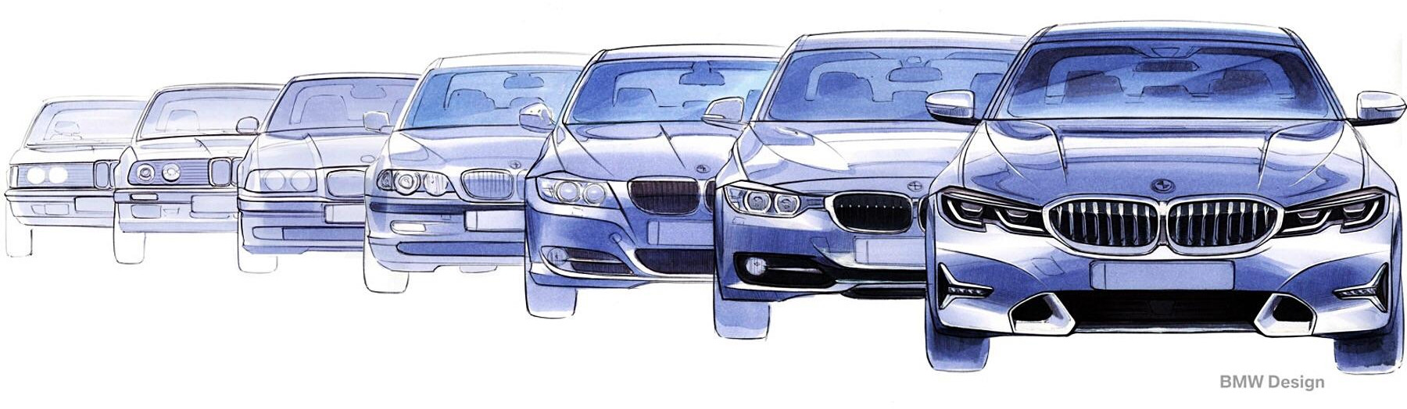
Why Quantity Matters?
Perfection Through Exploration
Healthier Project Budget

Slide 23
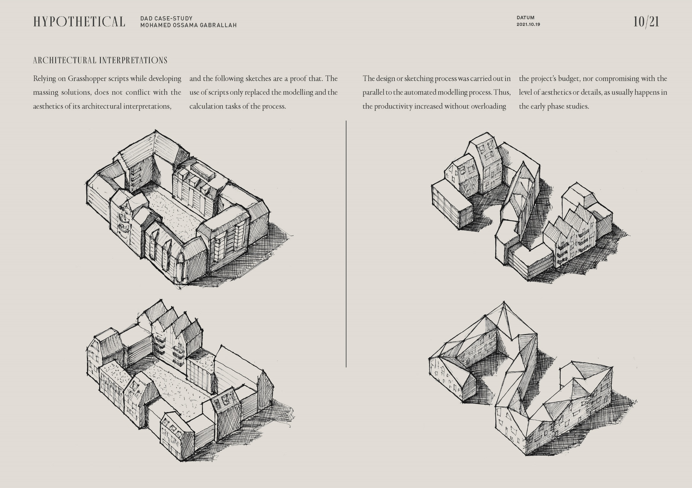
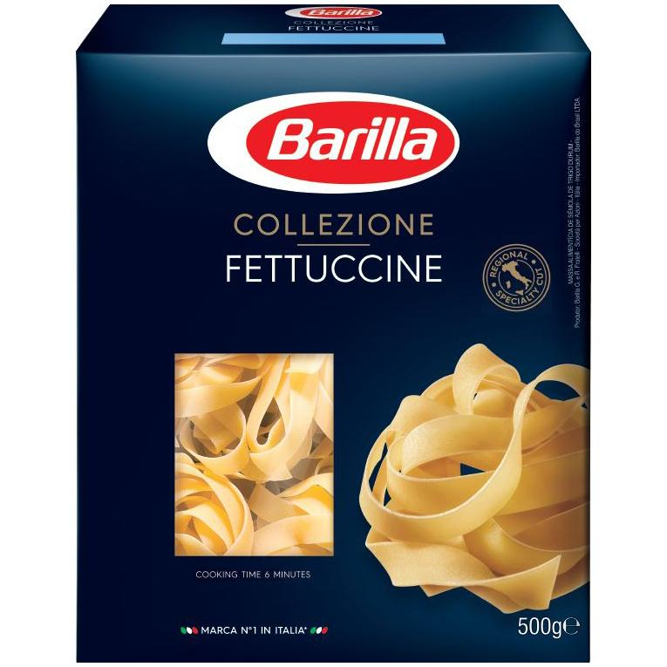

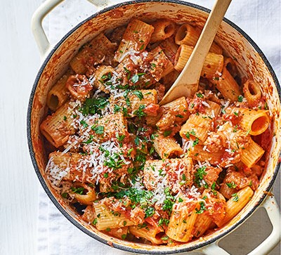
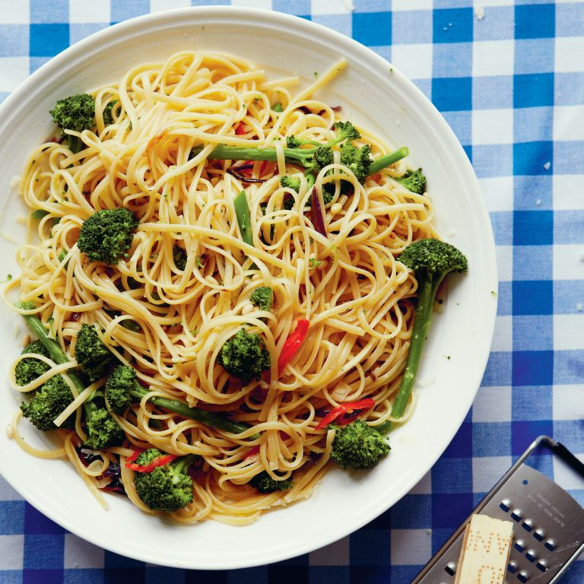
Adaptive & Recyclable
Does Not Mean Repetitive
Or Boring
Or Predictive

